Slide 1
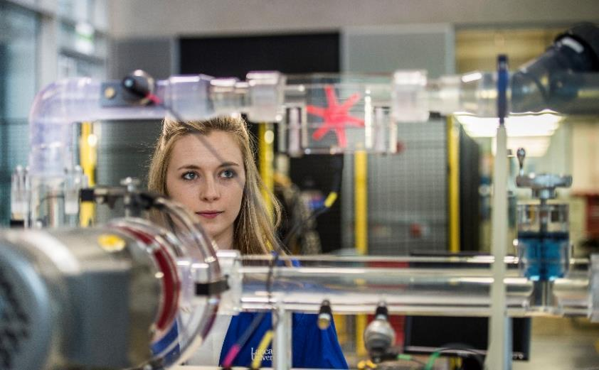
Engineering Interview Day
Dr Stephen Quayle
Director of Undergraduate Admissions

Slide 2

Agenda
Applicants
Guests
Asking questions is fundamental in all engineering disciplines
Applicants
Guests

Slide 3
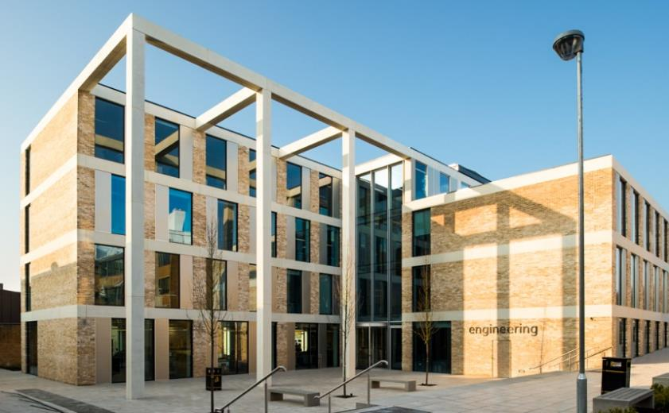
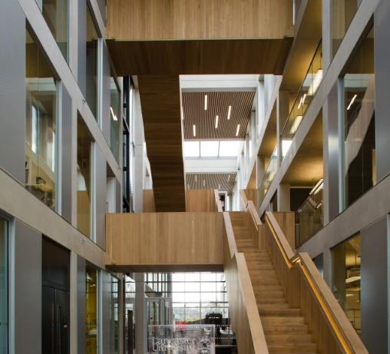
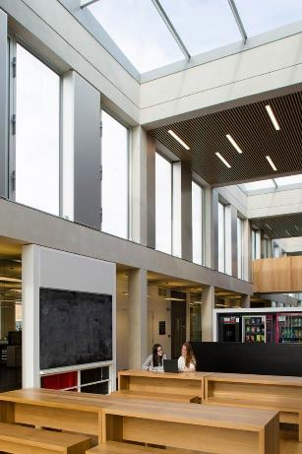


School Overview
General Engineering School
High-quality, research-led
High-quality student experience focussed on teaching quality
Practical, project-based learning
Fully accredited to CEng

Slide 4
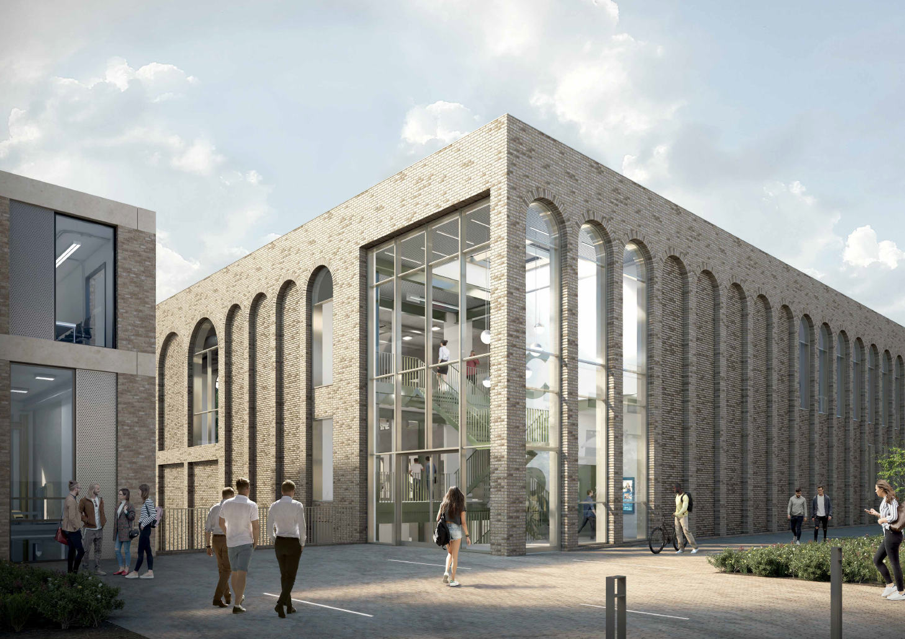
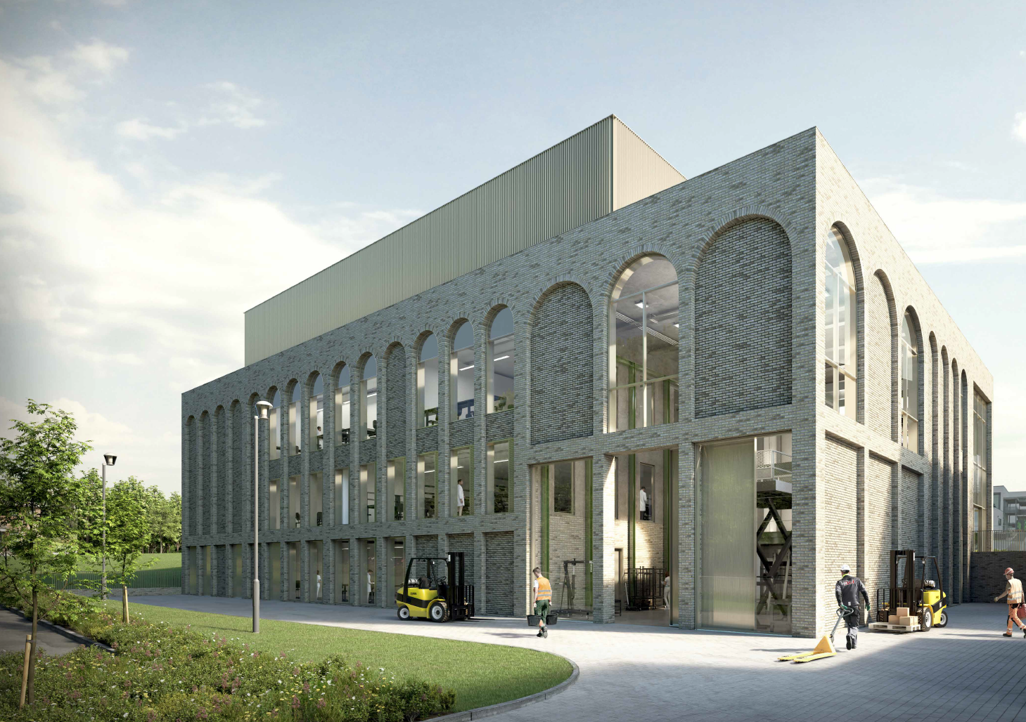
Engineering 2023
Apologies for the mess!

Slide 5
First Year Block plan
Fundamentals of Engineering Science
Statics & Structural Analysis
Analogue Electronics
Fluids, Heat Transfer & Thermodynamics
Chemistry fundamentals
Fundamentals of Engineering Applications
Software Engineering
Engineering Design
Manufacturing
Instrumentation
Process Engineering
Numerical and Analytical Methods in Engineering
Indices, logarithms, complex numbers, matrices vectors and scalars, functions, limits and series.
Differentiation and integration.
Fourier series, simultaneous linear equations, eigenvalues, Laplace transforms and partial derivatives, differential equations
Michaelmas Term
Lent Term
Summer Term
Group Tutorials and Project Work

Slide 6

Teaching
Typical First Year
  8 hours of lectures
  4 hours of lab and project work
  4 hours of maths workshops
  1 hour small group tutorial
  17 hours of weekly contact
  + online content
  + own study time
60% Exam, 40% Coursework

Slide 7

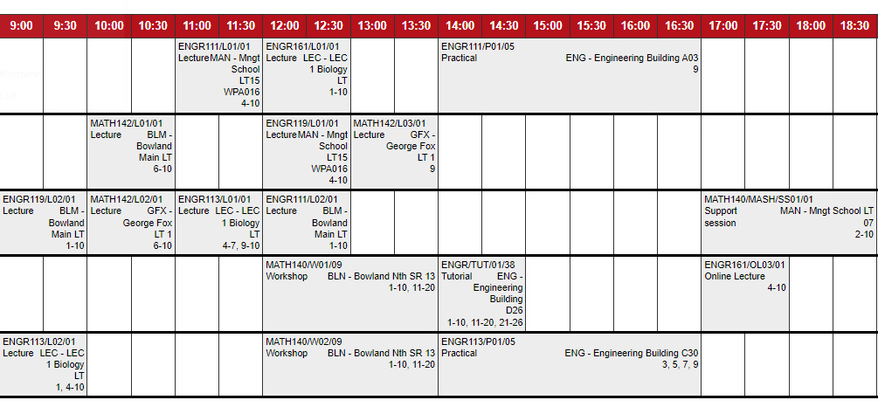
Timetable*
*Please note that this timetable is an example of a typical first year timetable and is not intended to be indicative of an actual first year’s timetable.

Slide 8

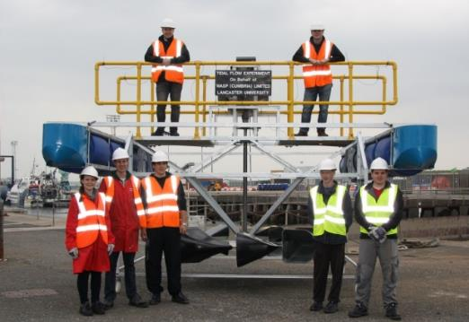
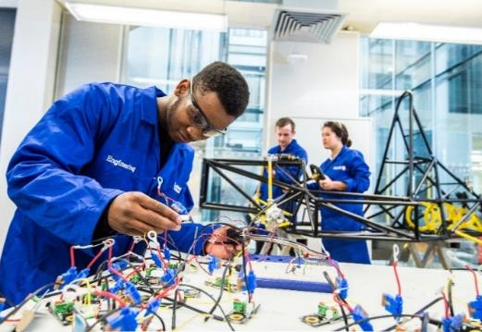
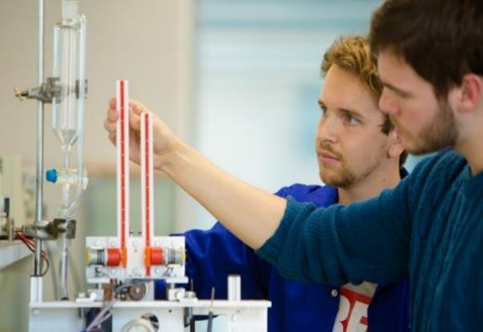
Practical Project-based Learning
An innovative educational framework for producing the next generation of engineers.
Education set in the context of real-world systems and products
Commended: The strong design thread that runs through the programmes exemplified by the emphasis on CDIO IMechE Accreditation 2021

Slide 9
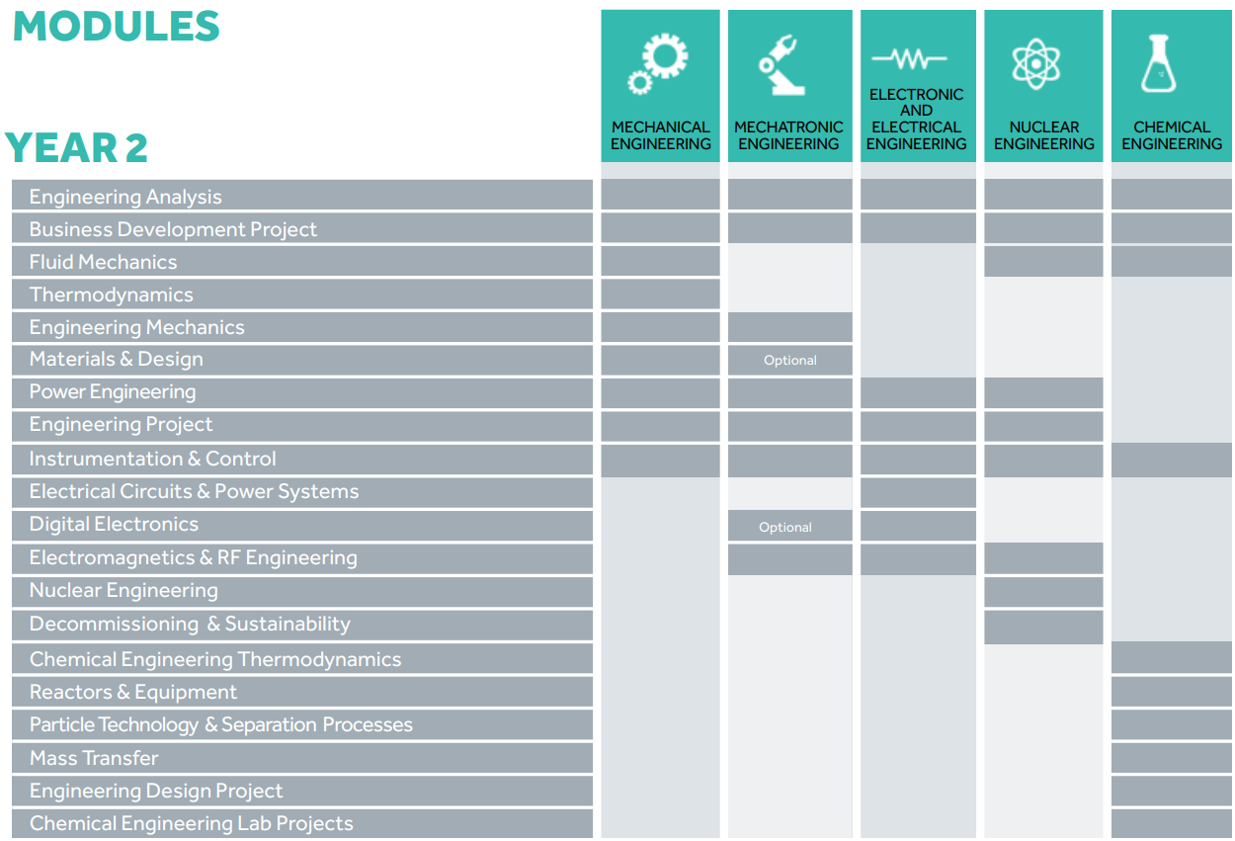
Second Year
  Select specialisation
Example classes
Common
  Business Development Project
  Option to Study Abroad
  *Modules indicative of typical programme

Slide 10
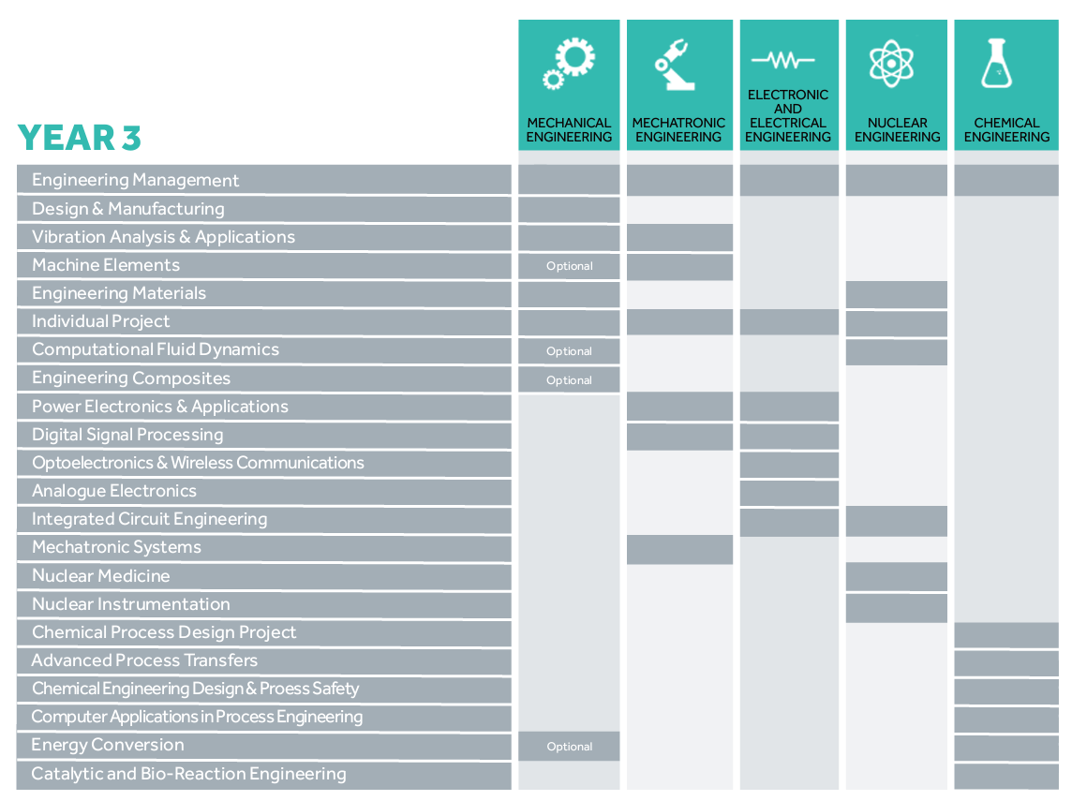
Third Year
Select BEng or MEng
Individual project
Chemical group project
Optional modules
Optional placement year
*Modules indicative of typical programme

Slide 11
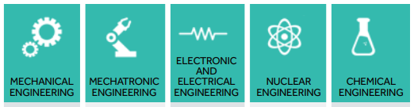
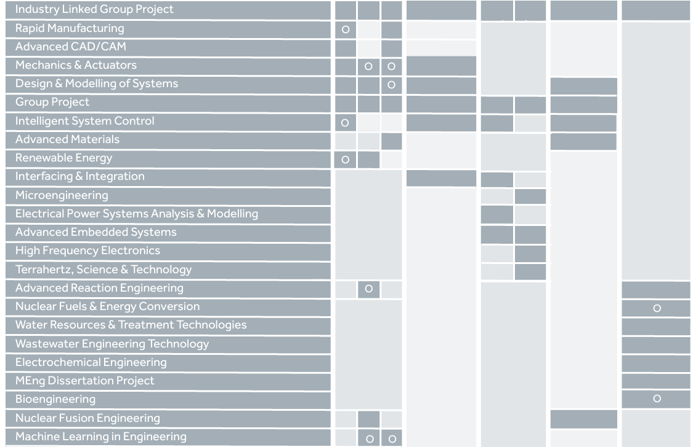
Fourth Year
MEng only
Group project
Chemical individual project
Intensive teaching
Industry linked group project
*Modules indicative of typical programme

Slide 12
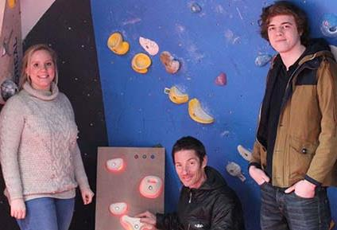
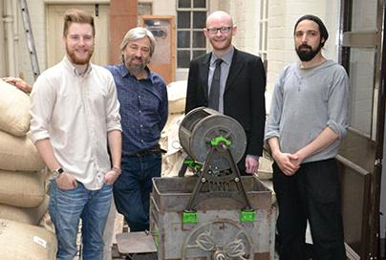
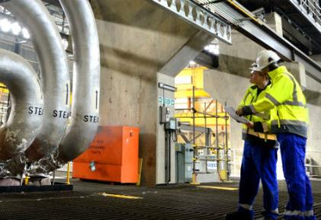
MEng Industry Experience
Two industry placement projects
Summer internships
Placement Year in industry

Slide 13
Leaving Details
Year 4
Year 3
Yr 2

Slide 14
Support Services
Academic support
  English Language Support
  Mathematics & Statistics Support
  Student Learning Advisors with 1 to 1 consultation
  Department Tutor/DoS
  College Advisers
Personal Support
  The ASK service
    Accommodation
    Careers
    Disability Services
    Visa and Immigration team
    Student Funding
    Student Registry
    Wellbeing, Counselling and Mental Health.
  Student Union
  Security
  Chaplaincy Centre & Islamic Prayer Room
  Your College
www.lancaster.ac.uk/sci-tech/study/academic-support
www.lancaster.ac.uk/student-and-education-services

Slide 15






Fees & Scholarships
£9250 UK Annual Student Fees (2022/23)
  ~£20 additional charge for safety shoes
  Complementary lab coat & safety glasses (+PPE)
£2,000 Lancaster Scholarship
  AAA at A level (and 5 GCSE’s grade A/7) - First year of study only, Firm UCAS choice.
£1,000 Lancaster Opportunity Scholarship
  Part of Contextual Offer Scheme, each year of study
£1,000 Lancaster Bursary
  Household income less than £30,000, each year of study

Slide 16
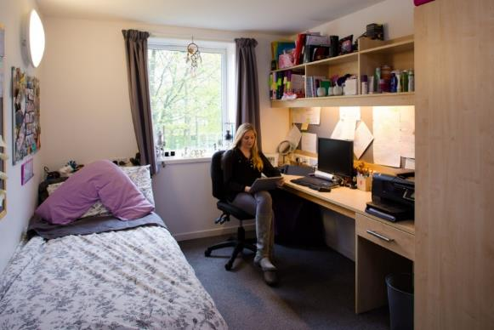
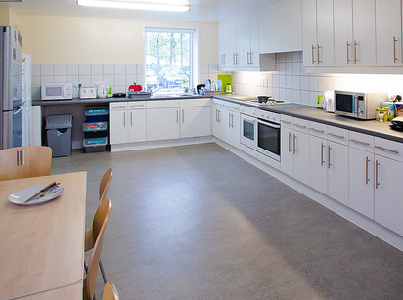
www.lancaster.ac.uk/accommodation
www.lancaster.ac.uk/virtual-tour/
Guaranteed 1st year accommodation on campus if you make Lancaster your Firm choice
Self-catered per week (typically 40 week lease)
  Standard £129.71
  Basic Ensuite £153.37
  Superior Ensuite £177.59
  Townhouse £159.95
Catered £213.92-£238.14* per week
Safe and secure environment
UK's Best University Halls eight times since 2010 at the annual National Student Housing Awards
*Lancaster University rents for 2023/24, inclusive of all bills
Notes:
Virtual online tours of all Lancaster accommodation

Slide 17












































Graduate Destinations
Notes:
Enthusiasm and Enjoyment
Good Academic Skills
Sense of Achievement
Creative, inquisitive
Team Player
Enjoy challenge

Slide 18

Questions?
www.lancaster.ac.uk/engineering
www.lancaster.ac.uk/study/undergraduate
www.cdio.org
www.engc.org.uk
ADMISSIONS TEAM
01524 593095/592275
engineering@lancaster.ac.uk

Slide 19

Student Talk
Nathan Leadbetter - Nuclear Engineering MEng
And
Izzy Crofts – Mechatronic Engineering MEng

Slide 20
*Please note that this timetable is an example of a typical first year timetable and is not intended to be indicative of an actual first year’s timetable.
Typical Week (Third Year)*
 | Monday | Tuesday | Wednesday | Thursday | Friday | Saturday | Sunday
7:00 |  | Frisbee Training
8:00 | Gym |  |  |  | Gym
9:00 |  |  |  |  |  | Part Time Job
10:00 |  |  | Self-Study | Lecture
11:00 | Self-Study | Lecture | Lecture |  | Project Work |  | Self-Study
12:00
13:00 | Lecture |  | Frisbee Game | Project Meeting
14:00 | Project Work | EWB Exec Meeting |  | Practical | Lecture |  | Frisbee Training
15:00 |  | Self-Study | Project Work
16:00 |  |  |  |  | Self-Study
17:00 |  |  |  |  | Practical
18:00 |  |  | Social (Optional) | EWB Event |  |  | Self-Study
19:00 |  |  |  |  | Social (Optional)
20:00
Key
Lectures
Other Scheduled Academic
Non-Scheduled Academic
Personal Time
Notes:
This is a typical week from my third year.
You all saw before what a typical week looks like for a first year in terms of scheduled academic sessions but most of university happens outside of these sessions.
As the years go on, there is less emphasis on structured lectures and more emphasis on self-study, especially when undertaking projects
As long as you can get the work done, the rest of the time is for yourself.
On Wednesday afternoons, there should be no scheduled academic sessions, allowing for people to take part in sports and societies. Usually if your on a sports team, this is when your games will be. Societies also run other events on different days of the week after around 6ish.
Wednesday and Friday nights are the main nights to hold socials. This is when societies get together to blow off some steam and relax. While many societies do go out to town, there is no pressure to drink, and there are even dedicated sober socials in each society, but more on them later.

Slide 21

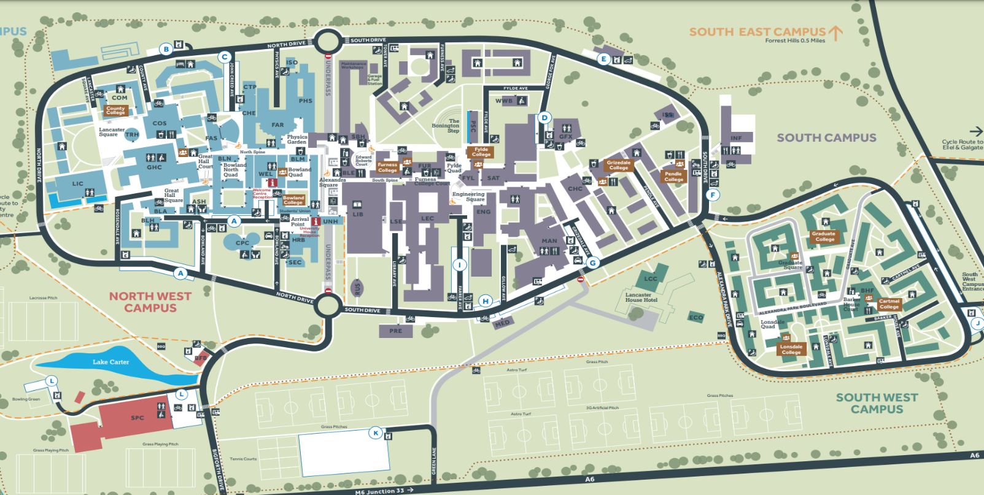








Collegiate System

Slide 22
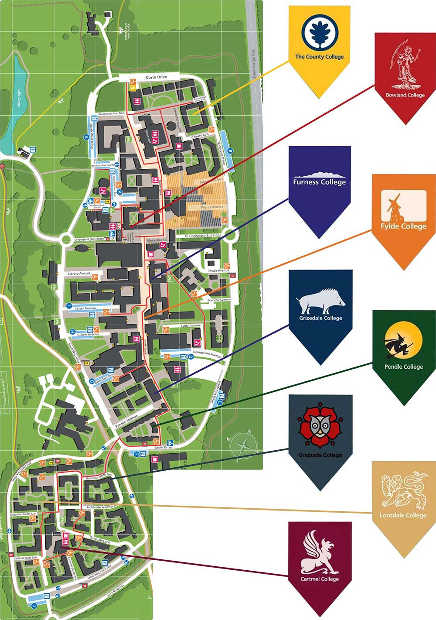
The Collegiate System and College Life
Lancaster University has 8 Undergraduate Colleges, and a separate Post-Graduate College.
Each college has their own JCR, bars, sports teams and welfare teams
Notes:
Lancaster University has 8 undergraduate colleges that act as a community throughout your years here. When you graduate after 3 or 4 years, you will graduate as part of your college.
These are assigned based off first year accommodation blocks.
Each college has its own bar, many of which serve food. All of the bars have their own vibe – for example Grizedale specialises in Cocktails and Fylde is your go-to to watch sport and grab some food.
But colleges are more than just a bar – each college has a JCR – students who are elected to run the college.
The JCR are in charge of any events that the college runs throughout the year.
Each college has their own dedicated welfare team who you can go to at anytime if you are struggling with pastoral needs.
Each college also has their own sports teams – mainly football, netball and bar sports

Slide 23
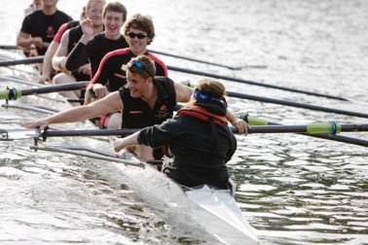
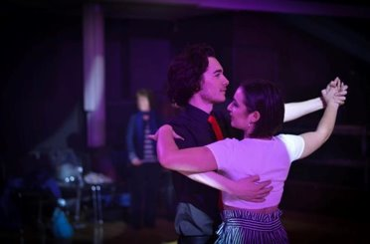
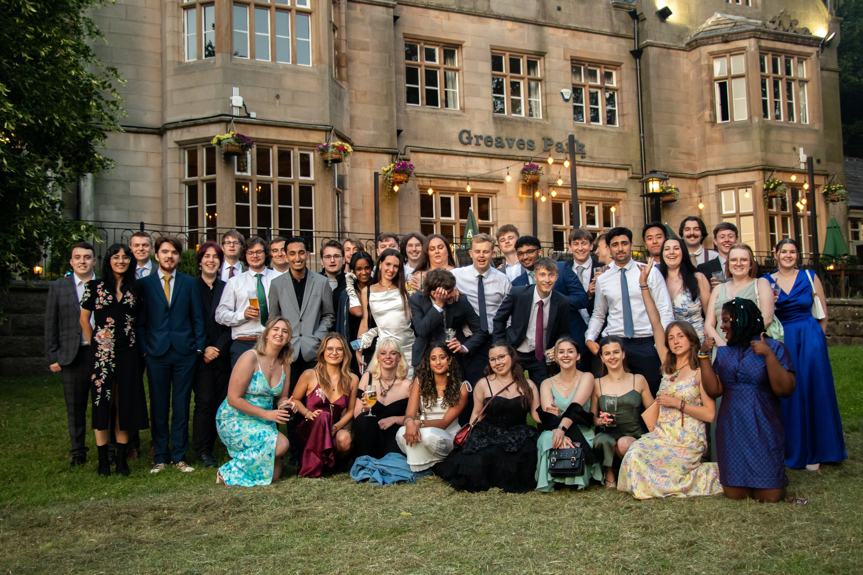
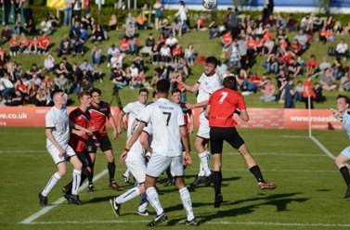
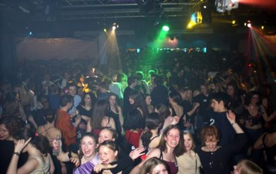

Sports and Societies
Notes:
University isn’t just about hitting the books and getting a degree. It’s about growing as a person and making lifelong friends.
This is where sports and societies are so important.
There are more than 160 societies covering a huge range of activities, hobbies and causes.
A society is a group of like-minded students, working together to do what they love. You can join a society to meet people who share your interests, to try something completely new, to discover a new culture or to increase your academic network.
My personal examples are that I play Ultimate Frisbee, and that I am the President of Engineers Without Borders. We work closely with the School to promote sustainability and global responsibility within engineering. We run events, projects, and outreach opportunities to spread this message while also improving our members CV’s. We also hold socials, like the engineering ball, so engineers can take a break and have fun with their coursemates

Slide 24

Societies
Creative & Performance
Faith, Culture, & Community
Media & Tech
Academic & Departmental
Political & Campaigning
Special Interest
Sports & Recreational

Slide 25
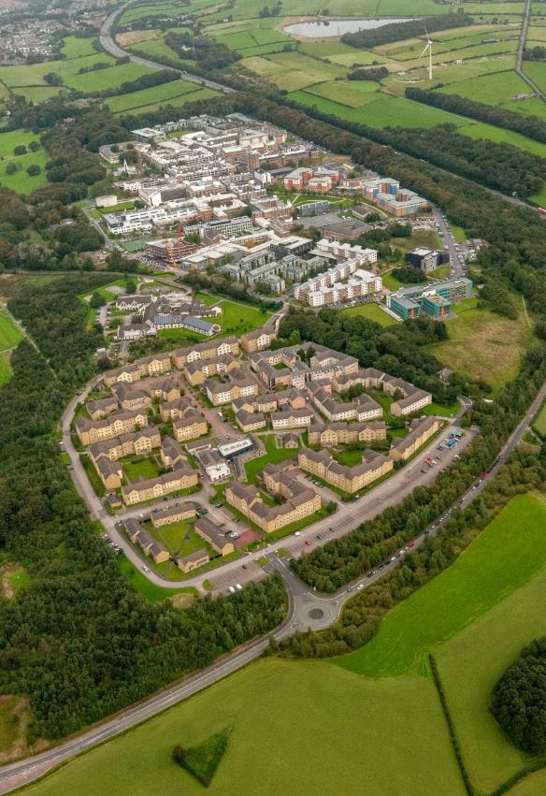
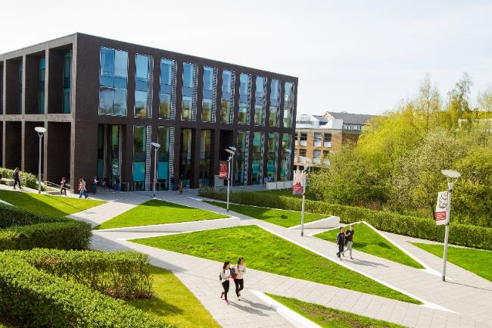
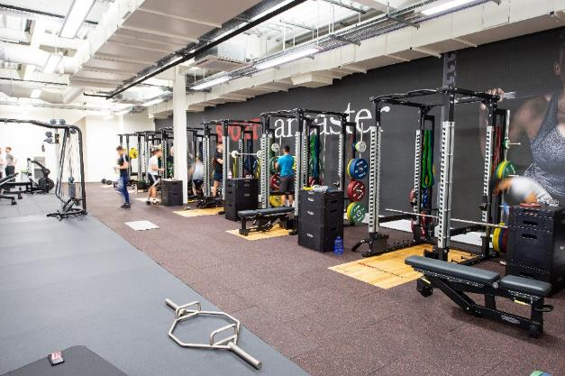
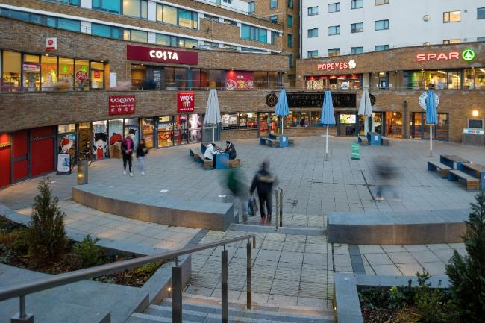
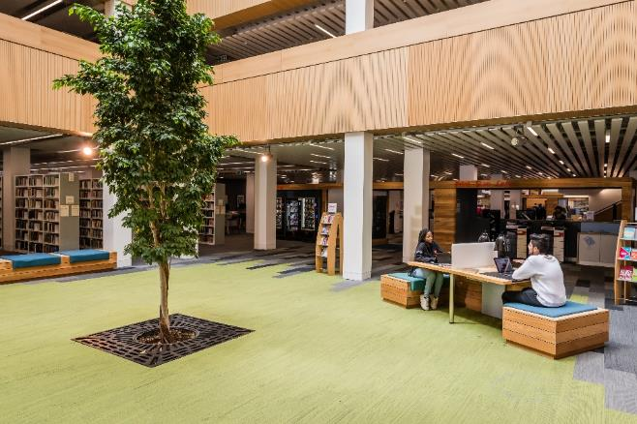
Life on Campus
Notes:
Campus based university
“Home away from home”
New undergraduates are encouraged to live on campus for their first year
Range of different bedroom types and for different budgets
Encouraged to pick the room type before the college
People you live with are from the same college, something you already have in common and colleges provide sense of community
Everything you need can be found on campus
Multiple restaurants and cafes
Spar and Central (Student Union Supermarket)
University 24/7 library
University sport centre/gym
24/7 campus security & campus is well lit
Pharmacy, GP, Post office, Chaplaincy, Student-run cinema, etc.
Personal experience of campus living

Slide 26
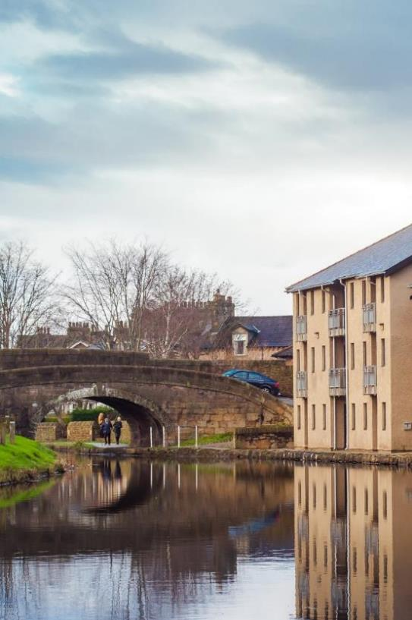


Living in the City
LUSU Living – Housing Office run by the Students’ Union
Private rented accommodation
Purpose built halls-of-residence in the city centre
Many students live in the city of Lancaster from year 2 onwards
Regular bus service
Notes:
Lancaster University Student Union Living Housing Office run by the Students’ Union
Accommodation in the city manged by them
Lancaster University Homes Accredited properties
Private rented accommodation
Chancellor's Wharf is the halls-of-residence in the city
Many students choose to live in the city after first year, some choose to stay or come back to campus in later years
Regular bus service between campus and the city
University hosts events to help students find accommodation and there are message boards to help find flatmates
Personal experience of campus living

Slide 27
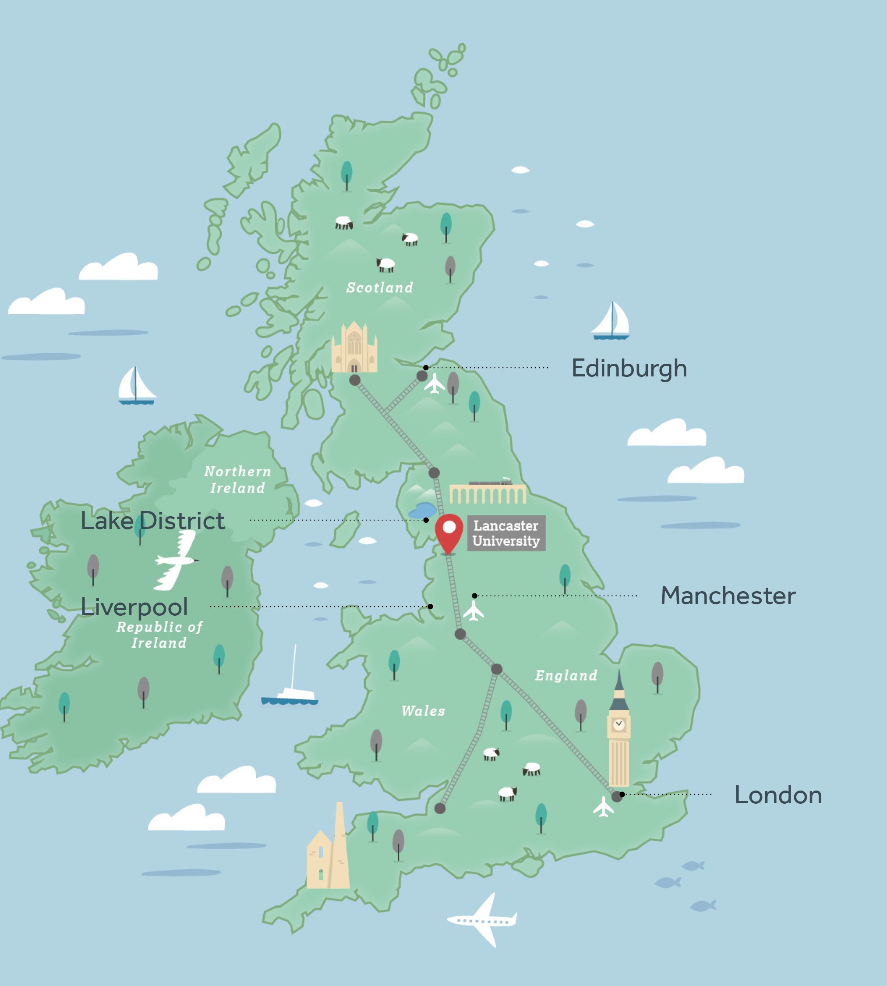
Transport
In and around Lancaster:
Buses – the underpass
Cycling – paths to campus
Walking – smaller city
Manchester (1 hour)
Liverpool (1.5 hours)
York (2 hours)
London (2.5 hours)
Edinburgh (2.5 hours)
Further afield (trains journeys):
London - 2hrs 30mins
Birmingham - 2hrs
Liverpool - 1hr 10mins
Manchester - 56mins
Edinburgh - 2hrs 10mins
Glasgow - 2hrs
Notes:
Reliable bus service between campus and city
Cycle routes between campus and city
Lots of places to lock up bikes
Repair service on campus
Big Bike Sale – reconditioned bikes at a good price
Lots to do and see in the area surrounding Lancaster
Buses and trains to local areas
Good for a day/weekend trip
Hiking/camping trips in lake district, shopping in Manchester etc.
Bus direct to the train station
On the main London to Edinburgh train route

Slide 28
Questions?
Engineering Societies
Engineering Society
facebook.com/groups/LUEngSoc
Women's Engineering Society
instagram.com/weslancasteruni
Engineers without Borders
facebook.com/ewblancaster
instagram.com/ewblancaster
Notes:
Social media for the 3 Engineering Societies
Time for questions

